Slide 1
Microsoft Teams Chat
A NEW WAY TO CONNECT

Slide 2
Contents
Weekly Sprint
Technology Used
Relating with Design Thinking
Prototype

Slide 3


Week 1
Problem statement + Exploring
Search for different working API and open source SKD’s.
Compare between bootstrap and CSS based on speed.
Why webrtc instead of websockets.
Design Prototype.
Try to make my first Competency
matrix.

Slide 4
Try to make Competency Matrix
Things to learn - Javascript Advance, peer-to-peer connection, webrtc, socket.io.
Aquired Skill – HTML, CSS, Javascript Basic
Weeks | Task | Completed/Not Completed
Week 1 | Search and Explore for the best the can be used. | Completed
Week 2 | Learn for the technology that are required. | Completed
Week 3 | Build the minimum requirement and add new feature. | Completed
Week 4 | Build Adapt feature.

Slide 5

Week 2
Technology to learn
Javascript Advance
2. Webrtc
3. Socket.io

Slide 6
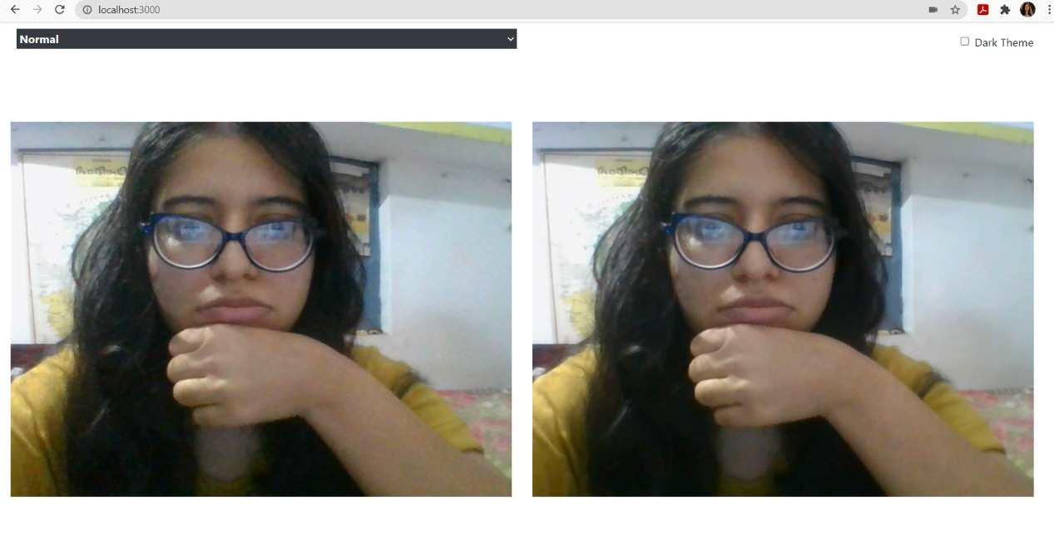
Week 3
Prototype building – Initial Product

Slide 7
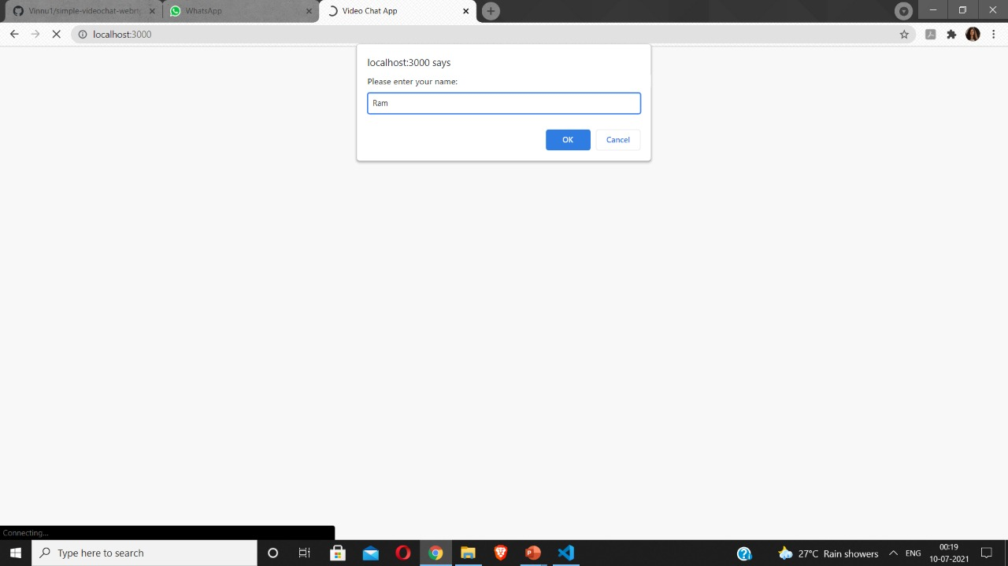
Week 4.1
Adapt feature –
Identify the user

Slide 8
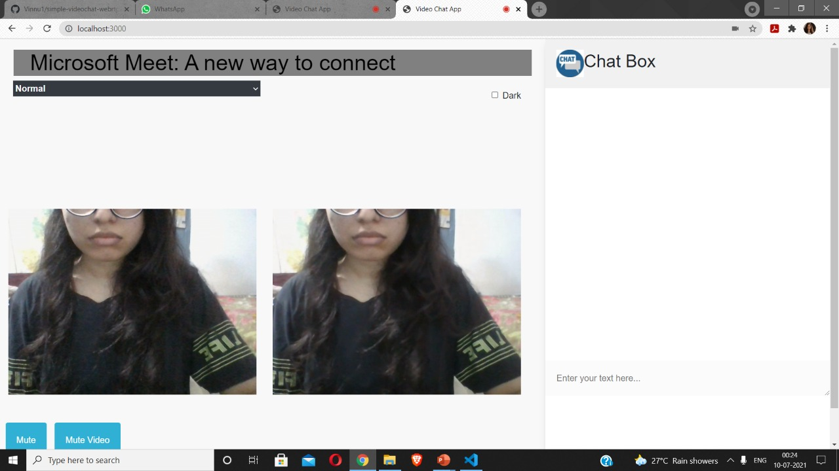
Week 4.2
User connected

Slide 9
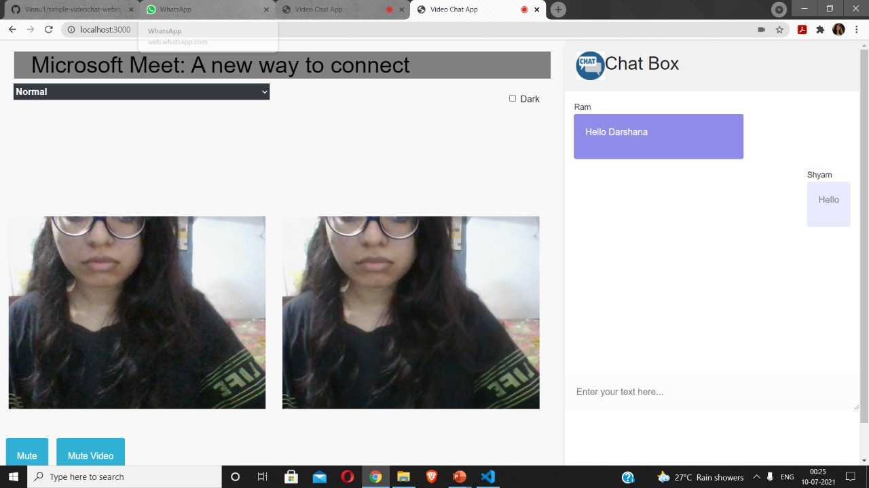
Week 4.3
Live Chat Feature

Slide 10
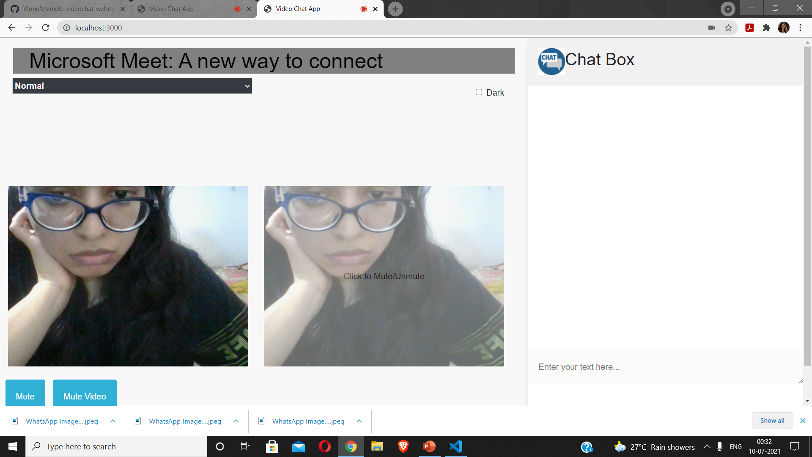
Features - 1
Click to Mute Feature

Slide 11
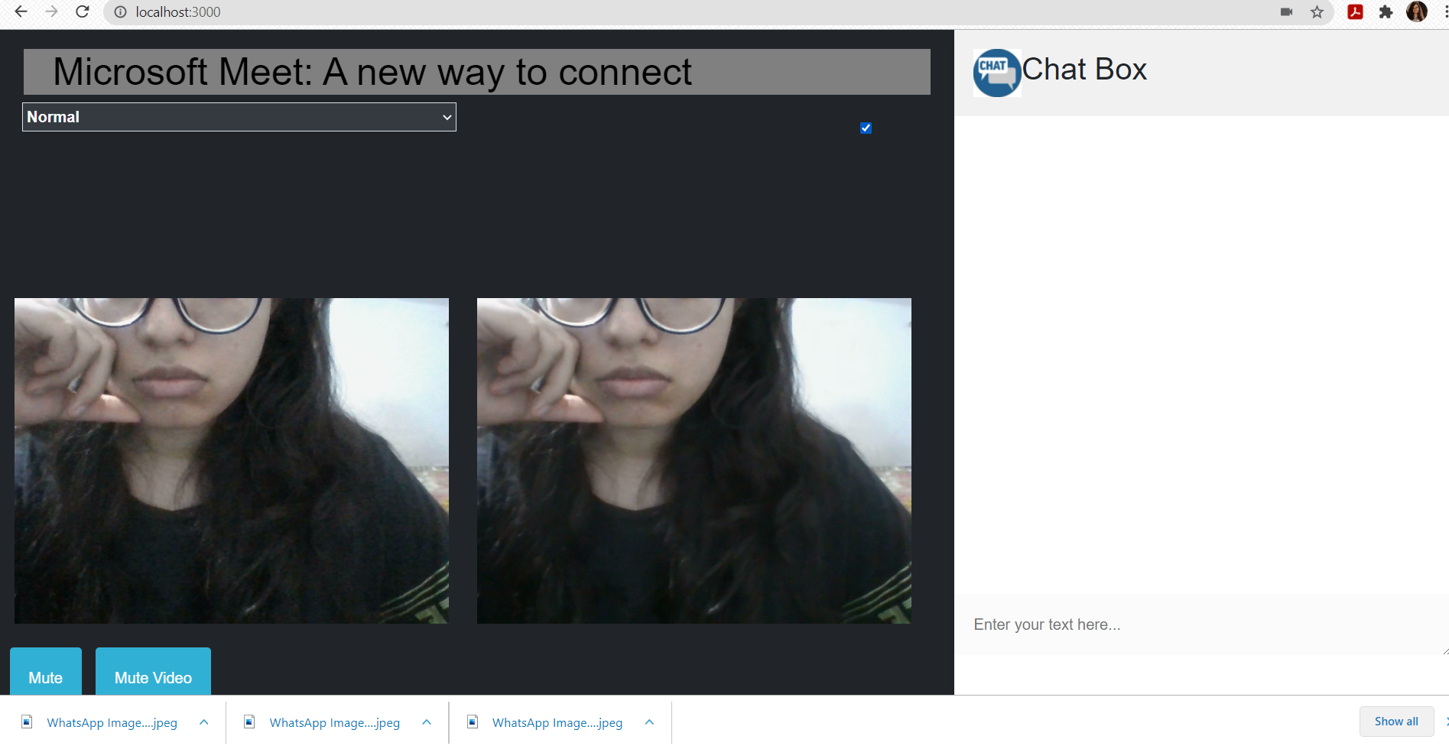
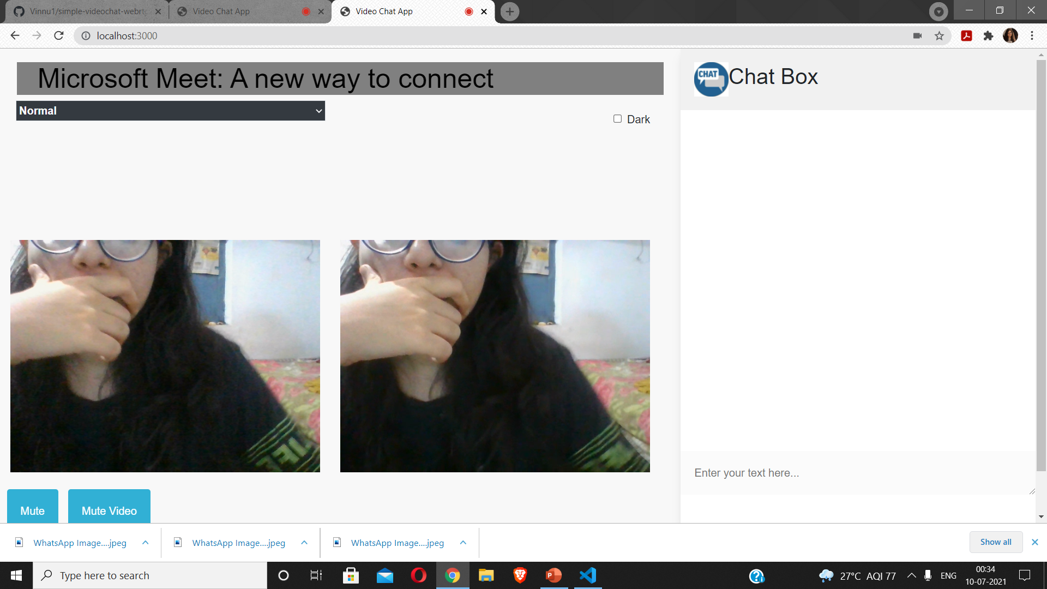
Feature - 2
Mode Switch Feature
Light Mode Dark Mode

Slide 12
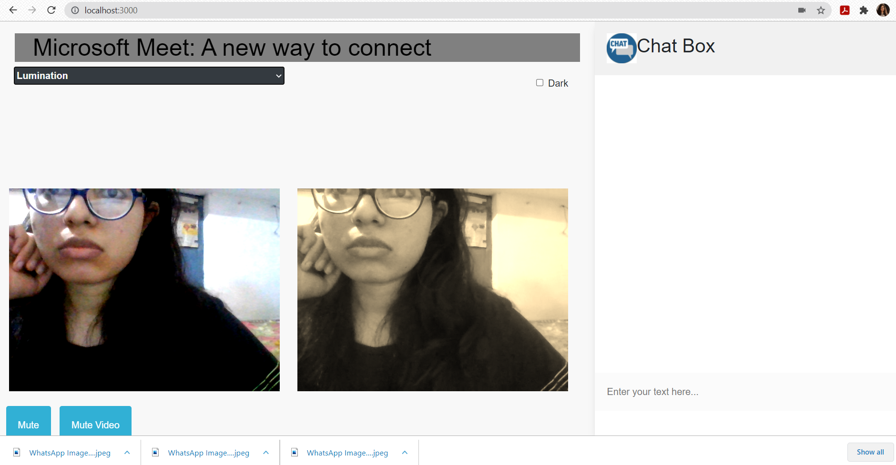
Feature - 3
Change video mode

Slide 13
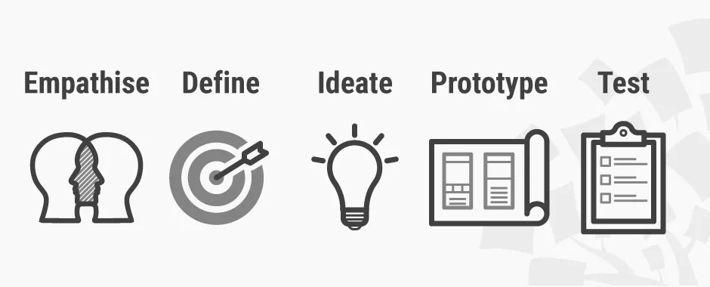
Use Design Thinking Ideation

